Slide 1
The D-Team
ENES100
Milestone 2 Presentation

Slide 2
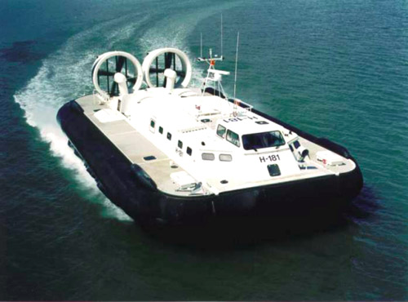
Group Organization
Team Members:
Bryan Weiner
Michael Bassett
Steve Ge
Alexa Tsintolas
Kushal Desai
David Dorsey
Joshua Hall
Julie Romanosky
Charles Wang
Michael DiBlasi
Meeting: Every Sunday at 5:00 pm
Project Leader: Bryan Weiner

Slide 3
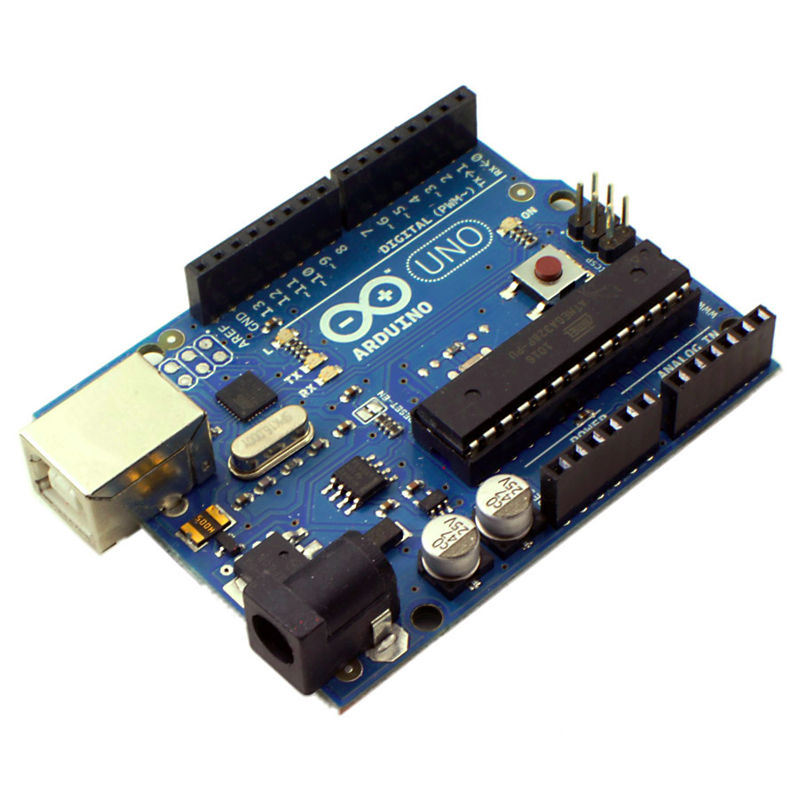
Subsystem Organization
Sensors and Control-
Leader: Charles Wang
Members: Kushal, Charles, Alexa, Steve
Meeting: Tuesdays 8 pm
Propulsion and Power-
Leader: Michael Bassett
Members: Julie, Michael, Bryan
Meeting: Sundays 6 pm
Structural and Levitation-
Leader: Joshua Hall
Members: Mike, Josh, David
Meeting: Sundays 4 pm

Slide 4
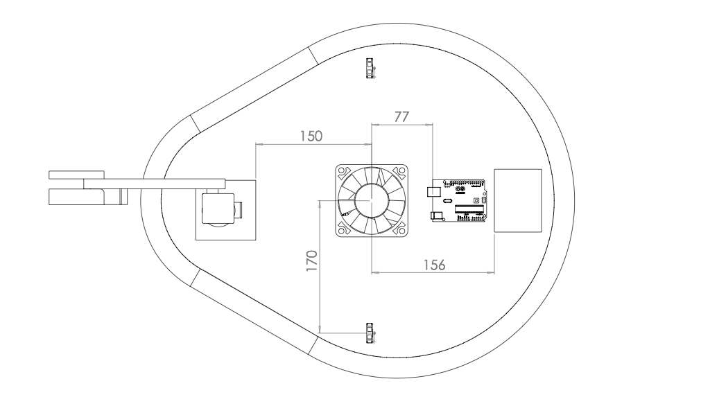
CAD Design

Slide 5
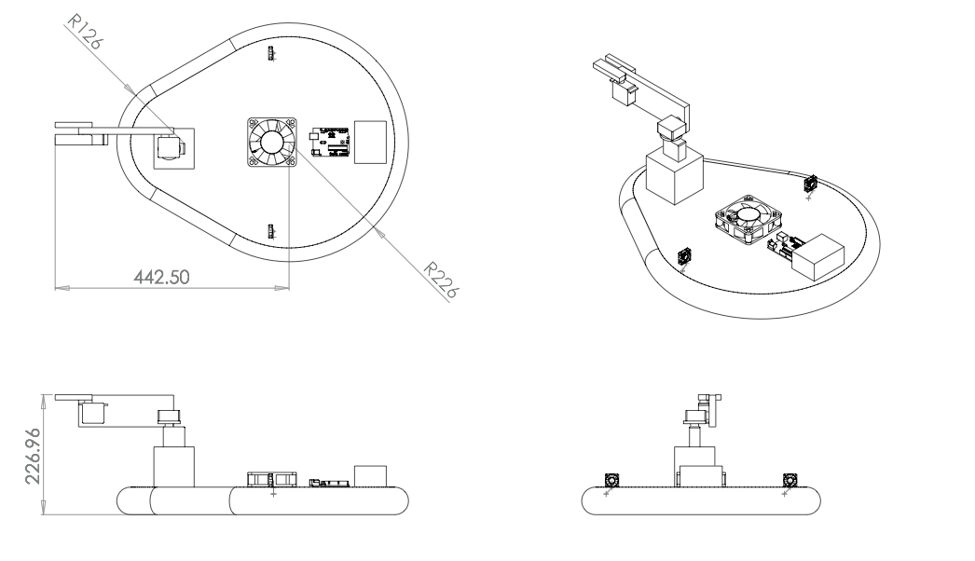
CAD Design Continued

Slide 6
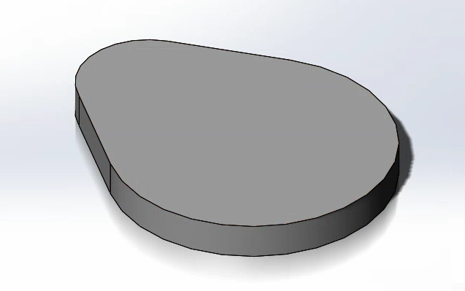
Structure System
The deck of our hovercraft resembles the shape of a pear, and will be made of styrofoam.
We chose this shape in order to maximize torque at the tailend of the craft while at the same time reducing unnecessary area from the front end. The front end of the craft will allow our payload system,noted later in the powerpoint, to reach farther while providing just enough space to fit.
The area of our pear shaped
design is 0.1462m^2
Estimated Mass: 2.4 Kg

Slide 7
Gantt Chart
https://excel.office.live.com/x/ExcelView.aspx?FBsrc=https%3A%2F%2Fwww.facebook.com%2Fdownload%2Ffile_preview.php%3Fid%3D617540581617644%26time%3D1382440113%26metadata&access_token=100000137031345%3AAVJUrgW-krBNzajcd9lBt87mn6AHxIzGG6HF0rn9SJXTcw&title=Gantt+Chart+10.21.13.xlsx

Slide 8
Skirt Attachment
Double Deck Construction:
A flat deck-like piece, made of cardboard, will be placed under the main deck, separated by support bars with a predetermined dimension.
Our skirt, made of ripstop nylon, will then be attached to the lower and upper deck with an adhesive.

Slide 9
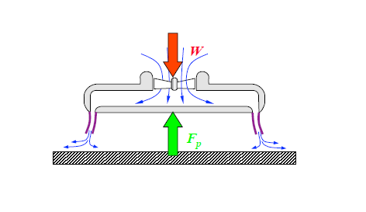
Levitation
In order for our hovercraft to levitate the force created due to pressure must balance the weight of the vehicle.
Fp = plenum pressure area of plenum
W = mass acceleration of gravity
P * Area = M * G

Slide 10
Levitation (Plenum Pressure)
P * Area = M * G
estimated M = 2.4 Kg with a 20% safety net
Area = .1462 m^2
G = 9.8 m / s^2
P = M * G / Area
P = 160 Pa

Slide 11

Levitation (Air Flow)
Through conservation of mass we can calculate the required airflow necessary for levitation
P = 160 Pa
Density of air = 1.19 Kg / m^3
Perimeter (l) = 1.393 m
We would like our hovercraft to hover at a height of 1mm
Qflow = 82.2 m^3 / hour

Slide 12
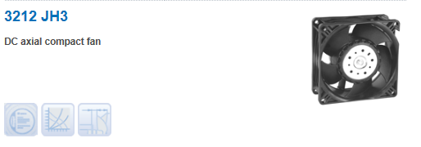
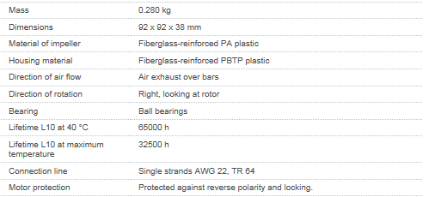
Levitation

Slide 13
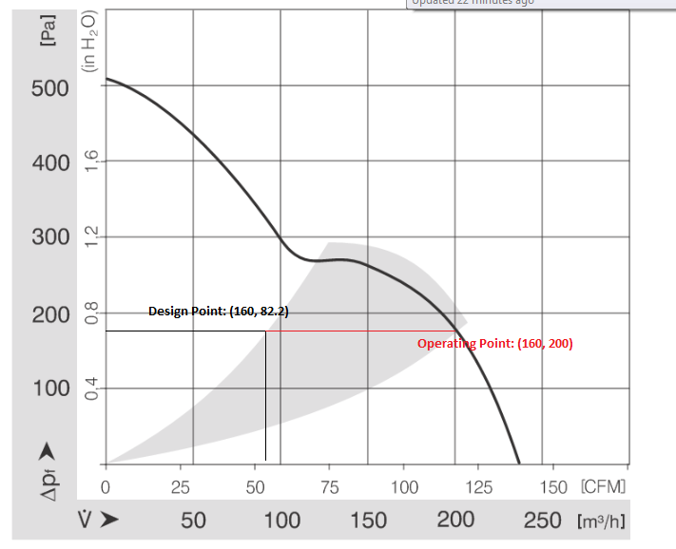
Levitation (Fan Characteristic)
Design Points:
P= 160 Pa
Q= 82.2 m^3/h
Operating Point:
P= 160 Pa Q= 200 m^3/h
Actual hover
~2.42 mm
(1 < 2.42 < 3)

Slide 14
Propulsion Fan Calculations
2 fans
calculation for Thrust
  Fnet= 2T-Ffs
  ma=2T-mg(.2)u
  (m2x/t^2+mg(.2)u)/2=T
  (2(2.4)(4)/(30^2)+(2.4)(9.81)(.2)(.2))/2=T
T= .4815N * 1.2 (fan guards)= .5778N
T=pQ^2/A where radius is 60mm.
  Q= sqrt. (TA/p)
  Q=6.2m^3/min
.2 below for reduction for levitating

Slide 15
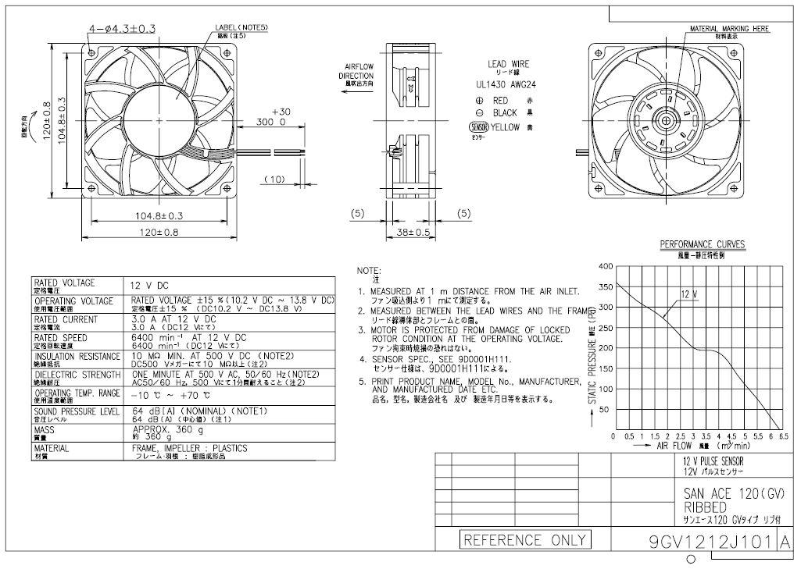
Propulsion Fan - Sanyo Denki

Slide 16
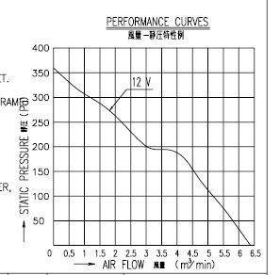
Propulsion
Operating Point: 223 CFM
max Q: 224.22 CFM
Fan Specs:
Sanyo Denki
9GV1212J101
120X120X38 [mm]
12V 3A
0.036 kg
We will use 2 of these fans mounted on the left and right of our hovercraft.

Slide 17
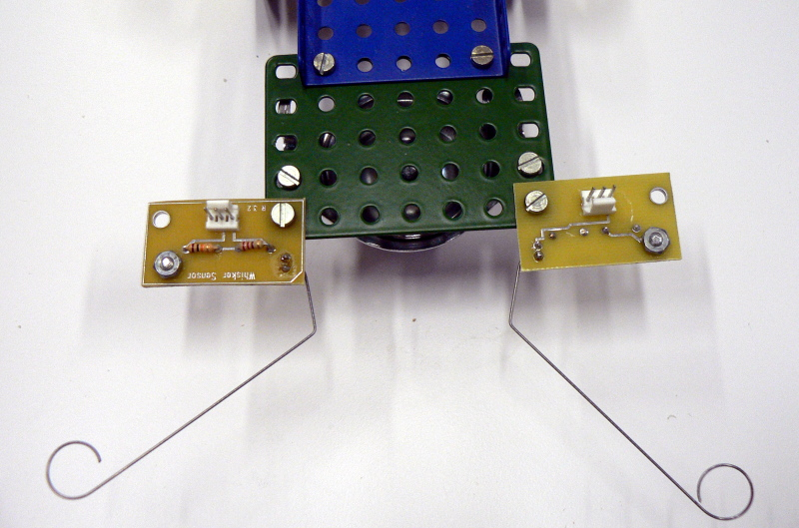
Sensors
3 photo sensors, 2 in a line, middle sensor farther back (prototype to find ideal location based off of final speed and turning radius of hovercraft)
beacon sensor to read data from RF beacon
touch whiskers to ensure correct contact with platform; rotate and change direction if needed

Slide 18
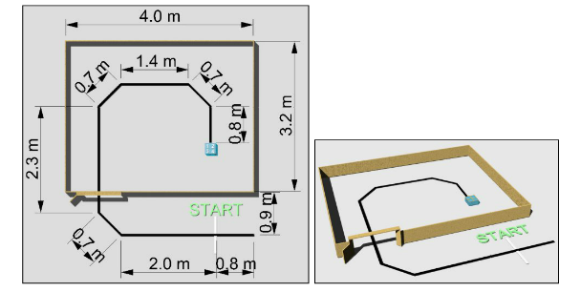
Programming
Hovercraft will follow line using its 3 photosensors
If only middle sensor sees black, it will move forward
If left sensor sees black, it will turn right, if right sensor sees black, it will turn left
Final position of sensors will be determined from prototyping

Slide 19
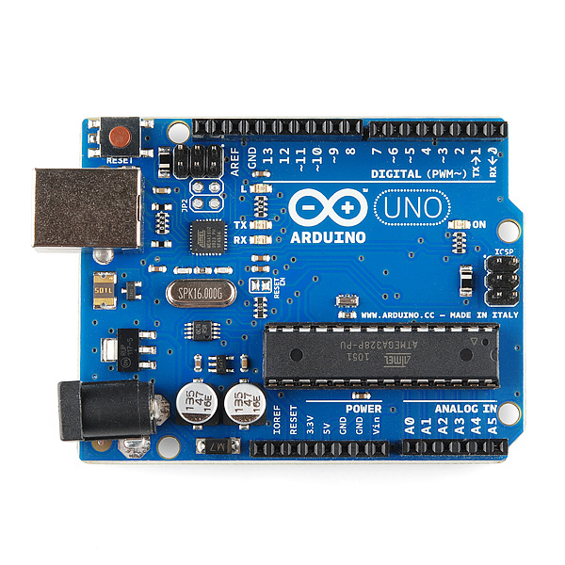
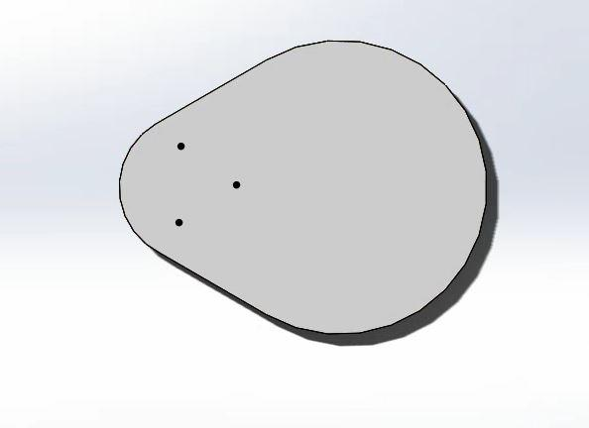
Programming
Photo sensors will be used to follow the black line up until the hovercraft reaches the box. Sensor placement is as shown.
Contact sensors will be used to confirm that we are oriented correctly against the box
RF sensor will determine the position of the required quadrant and premade code will be run to move the payload delivery arm over the correct box and release the payload

Slide 20
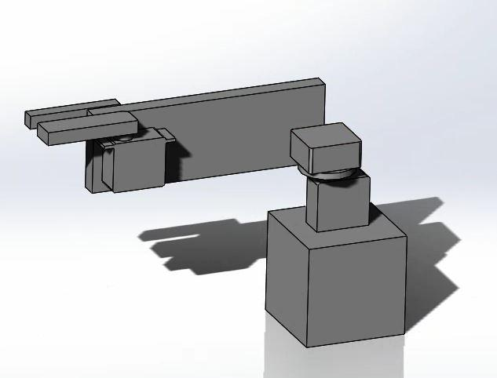
Payload Delivery
We plan on delivering the ping pong ball to the destination by using a robotic claw made up of wood and servo motors
The arm will be made up of three servo motors that will allow it to reach all four quadrants from standstill

Slide 21
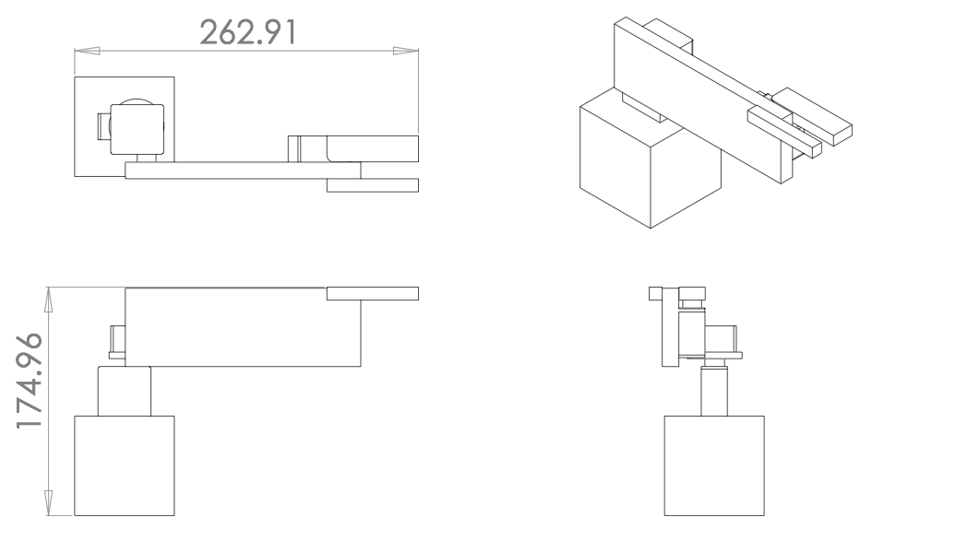
Payload CAD

Slide 22
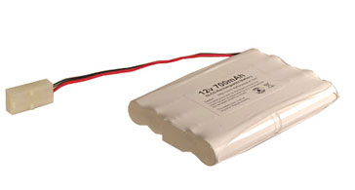
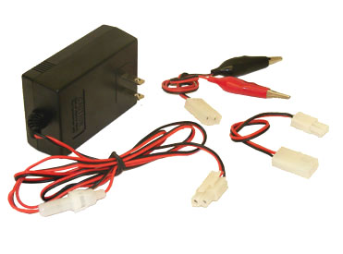
Power
http://www.batteryspace.com/nicdbatterypack12v700mah10xaaforrccarrc-daa10i5tm.aspx
http://www.batteryspace.com/Compact-Smart-Charger-0.6-A-for-RC-Car-6.0V---12-V-NiMH/-NiCd-Battery.aspx
NiCD Battery Pack: 12V 700 mAH from batteryspace.com powers levitation and propulsion fans
re-chargable using the smart charger linked above and shown to the right
two rows of five configuration
4’’(102mm) x 2.8’’(73mm) x .6’’(15mm)
weight 7.9oz (223grams)
Battery 2, which we are still looking for, is supposed to be 5.5 volts and this powers the Arduino and all it’s components.

Slide 23
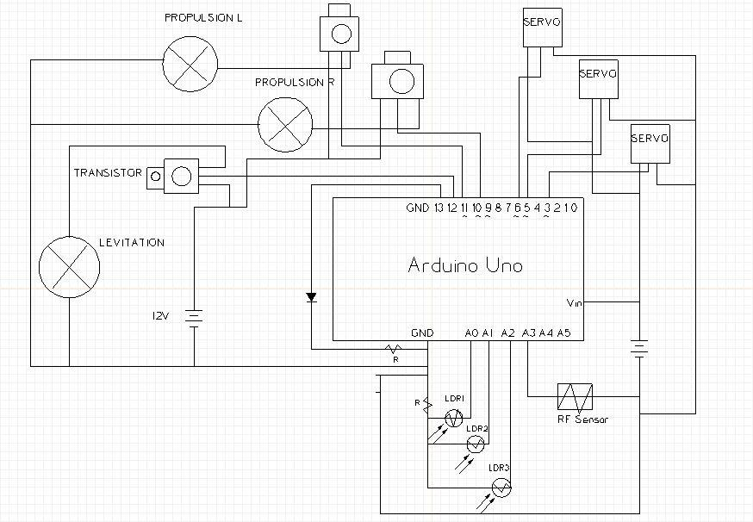
Circuit Diagram

Slide 24
List of Masses/ Moments
https://excel.office.live.com/x/ExcelView.aspx?FBsrc=https%3A%2F%2Fwww.facebook.com%2Fdownload%2Ffile_preview.php%3Fid%3D202270723278420%26time%3D1382442617%26metadata&access_token=100000137031345%3AAVLGrEDvJXBvcGH-yGr6WNys2azINdyHnczEDsQ3XphFhQ&title=Masses+and+Moments.xlsx

Slide 25
Bill of Materials
https://excel.office.live.com/x/ExcelView.aspx?FBsrc=https%3A%2F%2Fwww.facebook.com%2Fdownload%2Ffile_preview.php%3Fid%3D537199409692770%26time%3D1382441044%26metadata&access_token=100000137031345%3AAVLlDaUUev_0ZgmDxrgjqp122YTPpxIRd3qcV0qWXOPw3w&title=bill+of+materials+v2.xlsx
+materials+v2.xlsx

Slide 26
Problems and Resolutions
1. Must check blog if group meeting is missed.
http://teamdhovercraft.weebly.com/index.html
2. Inform group members if you are not able to make a scheduled meeting, ideally 24hrs in advance. Facebook post should be made.
3. If member of subgroup is not completing their assignments by their assigned deadlines, their designated subgroup determines the consequences. These may include but are not limited to: addressing the subgroup’s concerns to the professor, addressing their concerns to full group, etc..

Slide 27
Problems and Solutions
4. Missed Meetings:
Subgroup Meetings Missed:
If member is unable to make subgroup meetings to the point where it is a concern (ideally two meetings unexcused), subgroup should bring concern to specified person. If specified person does not respond to subgroup meeting (3 meetings total missed unexcused), attention to be brought to full group. If specified person does not respond to full group meeting (4 meetings total missed unexcused), professor should be notified. This rules are not definite and, depending on the scenario and how much effort specified person is doing to stay in touch and up to date with group members, the rules may be altered by a consensus amongst all group members.
Full Group Meeting Missed:
If member is unable to make two subgroup meetings, unexcused, group should warn specified person of their concern. Four meetings, unexcused, professor may be notified. Just as with the subgroup meetings, the rules may be altered depending on the situation by a consensus amongst all group members.

Slide 28
Anticipated Difficulties
Continuous battery usage time.
Alignment of hovercraft to delivery site.
Estimated calculations could be way off from actual values.
Complexity of Arduino code.
Balancing the hovercraft MMI.
-Including when payload arm is in motion.
Rotation due to the levitation fan.

